Slide 1

Subject Code
18MEO113T - Design of Experiments
Handled by
S. Murali, Ph.D.,
Associate Professor,
Department of Mechanical Engineering, SRM IST, Kattankulathur.
Disclaimer
The content prepared in the presentation are from various sources, only used for education purpose. Thanks to all the sources.

Slide 2
Unit 5

Slide 3
Unit 5
1: Introduction and uses of confounding
2: 2³ factorial experiment with complete confounding
3: 2³ factorial experiment with partial confounding
4: Confounding in the 2^{n} series and examples
5: Confounding of 3^{n} factorial and examples
6: ANOVA (One-way and two-way, higher-way ANOVA)
7: MANOVA and ANCOVA overview
8: Solving Case studies on ANOVA with statistics software
9: Regression Models and Regression Analysis

Slide 4
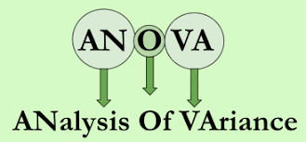
ANOVA
Analysis of Variance (abbreviated as ANOVA)
ANOVA was developed by Fisher in the early 1920s, and initially applied to agricultural experiments. Used extensively today for industrial experiments.
The ANOVA technique enables us to perform to examine the significance of the difference amongst more than two sample means at the same time.
Using this technique, one can infer whether the samples have been drawn from populations with the same mean.

Slide 5
ANOVA
ANOVA is a procedure for testing the difference among different data groups for homogeneity.
Variance is an important statistical measure described as the mean of the squares of deviations taken from the mean of the given data series. It is a frequently used measure of variation. The square of standard deviation is called as the variance.
i.e., Variance = (Standard deviation)²
There may be variation between samples and also within sample items.

Slide 6
ANOVA
An ANOVA test is a way to find out if survey or experiment results are significant.
In other words, ANOVA help us to figure out if there is a need to reject the null hypothesis or accept the alternative hypothesis.
Basically, we’re testing groups to see if they are different.

Slide 7
ANOVA
Example:
A group of psychiatric patients are trying three different therapies: counselling, medication and biofeedback. We want to see if one therapy is better than the others.
A manufacturer has two different processes to make light bulbs. They want to know if one process is better than the other.
Students from different colleges take the same exam. You want to see if one college outperforms the other.

Slide 8
ANOVA
Example:
A Manager wants to evaluate the performance of three(or more) employees to see if any performance different from others.
A Marketing executives want to see if there is a difference in sales productivity in the 5 company region.
A Teacher wants to see if there is a difference in students performance if he use 3 or more approach to teach.

Slide 9
ANOVA
ANOVA is two types:
One Way ANOVA: Only one factor is investigated
One independent variable (With 2 levels)
Analysis of Variance could have one independent variable
Two Way ANOVA: Investigate two factors at the same time
Two independent variables (can have multiple levels)
Analysis of Variance could have two independent variables
Two way ANOVA without replication
Two way ANOVA with replication
Notes:
https://www.slideshare.net/sonustar3/anova-analysis-of-variance-90850361

Slide 10
ANOVA
Two way ANOVA without replication
We are testing one set of individual before and after they take a medication to see if it works or not.
Two way ANOVA with replication
Two groups, and the members of those groups are doing more than one thing.
For example, two groups of patients from different hospitals trying two different therapies.

Slide 11
ANOVA
Three way ANOVA
A three-way ANOVA tests which of three separate variables influence an outcome, and the relationship between the three variables. It is also called a three-factor ANOVA.

Slide 12
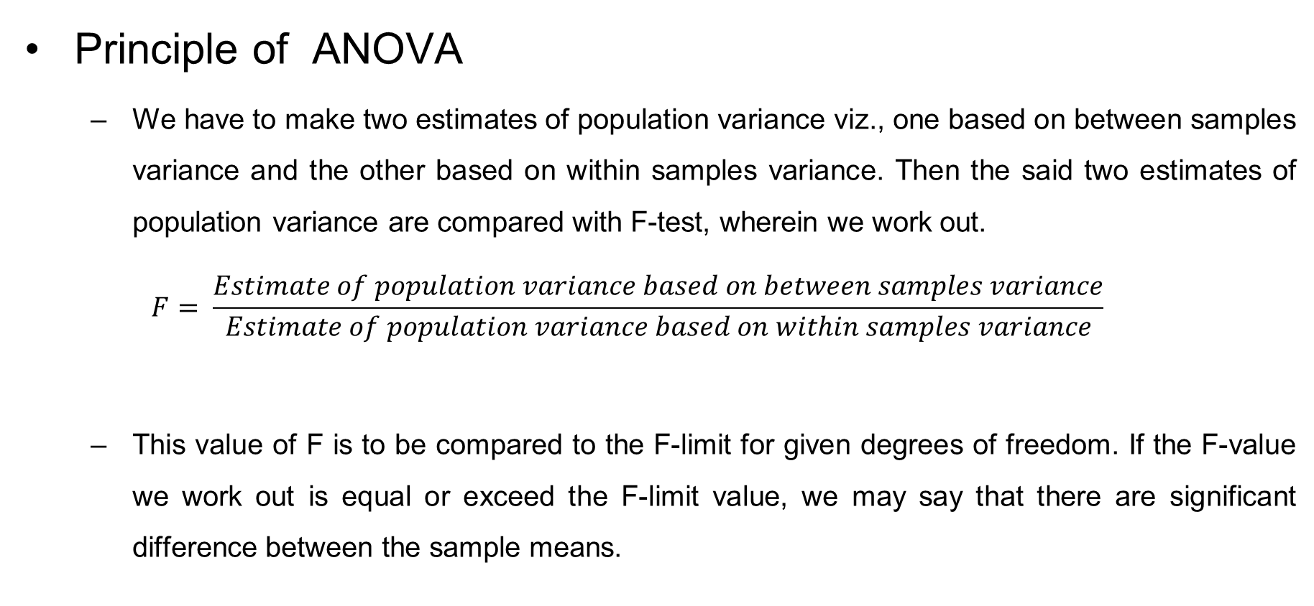
ANOVA
Principle of ANOVA
We have to make two estimates of population variance viz., one based on between samples variance and the other based on within samples variance. Then the said two estimates of population variance are compared with F-test, wherein we work out.
$$F= \frac{Estimate of population variance based on between samples variance}{Estimate of population variance based on within samples variance}$$
This value of F is to be compared to the F-limit for given degrees of freedom. If the F-value we work out is equal or exceed the F-limit value, we may say that there are significant difference between the sample means.

Slide 13
ANOVA
ANOVA Technique
Obtain the mean of each sample
Work out the mean of the sample means
Calculate sum of squares for variance between the samples (or SS between)
Obtain variance or mean square (MS) between samples
Calculate sum of squares for variance within samples (or SS within)
Obtain the variance or mean square (MS) within samples
Find sum of squares of deviation for total variance
Finally, find F-ratio.

Slide 14
One-way ANOVA
A one way ANOVA is used to compare two means from two independent (unrelated) groups using the F-distribution.
The null hypothesis for the test is that the two means are equal.
Therefore, a significant result means that the two means are unequal.
Alternate hypothesis …? Two means are not equal..

Slide 15
One-way ANOVA
Note
The independent variable is the categorical variable that defines the compared groups. E.g., instructional methods, grade level, or marital status.
The dependent variable is the measured variable whose means are being compared e.g., level of job satisfaction or text anxiety.

Slide 16
One-way ANOVA
Examples of when to use a one-way ANOVA
Situation 1: You have a group of individuals randomly split into smaller groups and completing different tasks. For example, you might be studying the effects of tea on weight loss and form three groups: green tea, black tea, and no tea.

Slide 17
One-way ANOVA
Examples of when to use a one-way ANOVA
Situation 2: Similar to situation 1, but in this case, the individuals are split into groups based on an attribute they possess. For example, you might be studying the leg strength of people according to weight. You could split participants into weight categories (obese, overweight and normal) and measure their leg strength on a weight machine.

Slide 18
One-way ANOVA
Limitation of the one-way ANOVA
A one-way ANOVA will tell you that at least two groups were different from each other. But it won’t tell you which groups were different. If your test returns a significant f-statistic, you may need to run an ad hoc test (like the Least Significant Difference test) to tell you exactly which groups had a difference in means.

Slide 19
One-way ANOVA
Assumptions
1. Your dependent variable should be measured at the interval or ratio scales (i.e., they are continuous)
Examples of variable that meet this criterion include, revision time (measured in hours), intelligence (measured using IQ score), exam performance (measured from 0 to 100), weight (measured in kg)

Slide 20
One-way ANOVA
Assumptions
2. Your independent variable should consist of two or more categorical, independent groups. Typically, a one-way ANOVA is used when you have three or more categorical, independent groups, but it can be used for just two groups (but an independent-samples t-test is more commonly used for two groups)
Examples independent variables that meet this criterion include ethnicity (e.g., 3 groups: Indian, Chinese, Korean), physical activity level (e.g., 4 groups: sedentary, low, moderate and high), profession (e.g., 5 groups: surgeon, doctor, nurse, dentist, therapist), and so forth.

Slide 21
One-way ANOVA
Assumptions
3. You should have independence of observations, meaning there is no relationship between the observations in each group or between the groups themselves.
Example: it is an important assumption of one-way ANOVA. If your study fails this assumption, you will need to use another statistical test instead of the one-way ANOVA (e.g., a repeated measures design)

Slide 22
One-way ANOVA
Assumptions
4. There should be no significant outliers. Outliers are simple single data points within your data that do not follow the usual pattern.
Example: In a study of 100 students’ IQ scores, where the mean score was 108 with only a small variation between students, one student had a score of 156, which is very unusual.
The problem with outliers is that they can have a negative effect on the one-way ANOVA, reducing the validity of your results.

Slide 23
One-way ANOVA
Assumptions
5. Your dependent variable should be approximately normally distributed for each category of the independent variable.
One-way ANOVA only requires approximately normal data because it is quite “robust” to violations of normality, meaning that assumption can be a little violated and still provide valid results. The Kolmogorov–Smirnov test and the Shapiro–Wilk test are most widely used methods to test the normality of the data

Slide 24
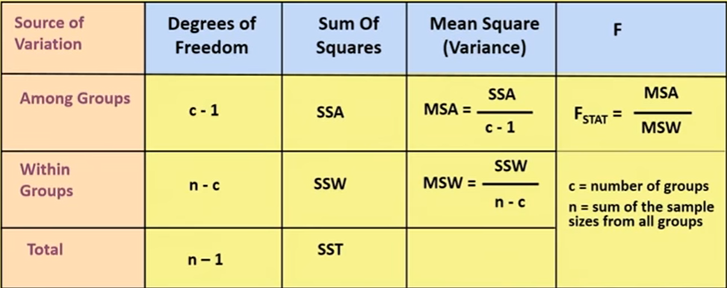
One-way ANOVA
Assumptions
6. There needs to be homogeneity of variances.

Slide 25
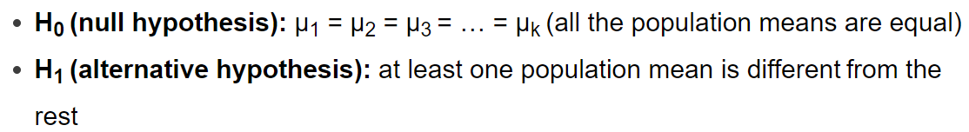
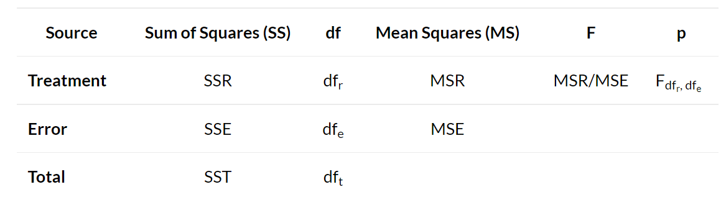
One-way ANOVA Process
A one-way ANOVA uses the following null and alternative hypotheses:

Slide 26
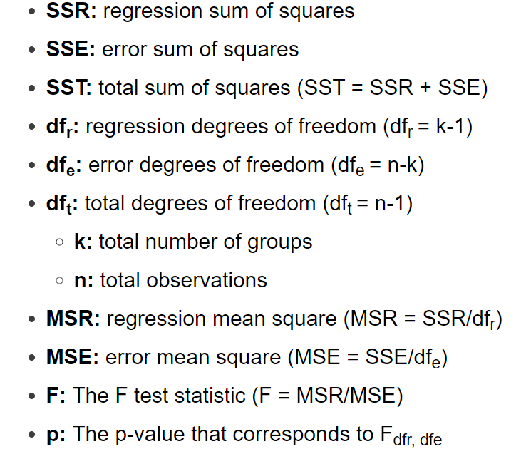
One-way ANOVA Process
If the p-value is less than your chosen significance level (e.g. 0.05), then you can reject the null hypothesis and conclude that at least one of the population means is different from the others.
Note: If you reject the null hypothesis, this indicates that at least one of the population means is different from the others, but the ANOVA table doesn’t specify which population means are different. To determine this, you need to perform post hoc tests, also known as “multiple comparisons” tests.
Notes:
https://www.statology.org/one-way-anova/

Slide 27
One-way ANOVA (Problem 1)
Suppose we want to know whether or not three different exam preparation programs lead to different mean scores on a certain exam. To test this, we recruit 30 students to participate in a study and split them into three groups. The students in each group are randomly assigned to use one of the three exam preparation programs for the next three weeks to prepare for an exam. All students take the same exam at the end of the three weeks.

Slide 28
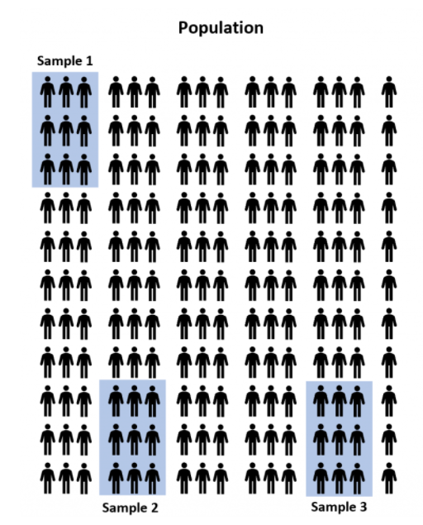
One-way ANOVA (Problem 1)
Since there are millions of high school students around the country, it would be too time-consuming and costly to go around to each student and let them use one of the exam prep programs. Instead, we might select three random samples of 100 students from the population and allow each sample to use one of the three test prep programs to prepare for the exam. Then, we could record the scores for each student once they take the exam.

Slide 29
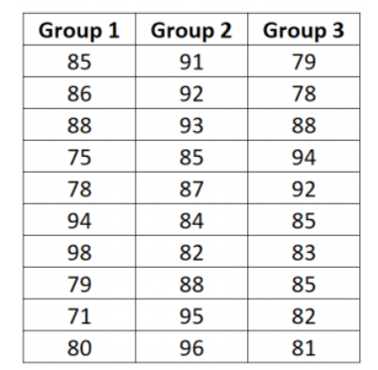
One-way ANOVA (Problem 1)
The exam scores for each group are shown below:
Determine if the mean exam score is different between the three groups:

Slide 30
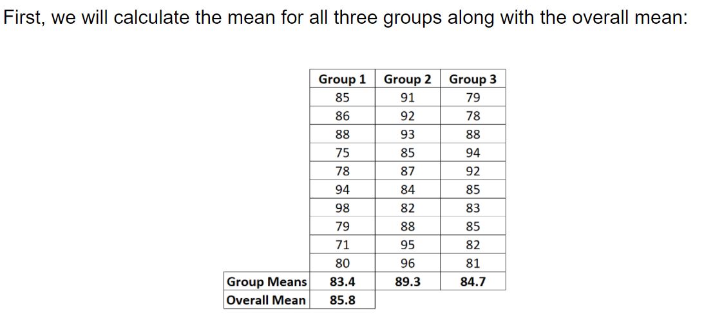

One-way ANOVA (Problem 1)
Step 1: Calculate the group means and the overall mean.

Slide 31
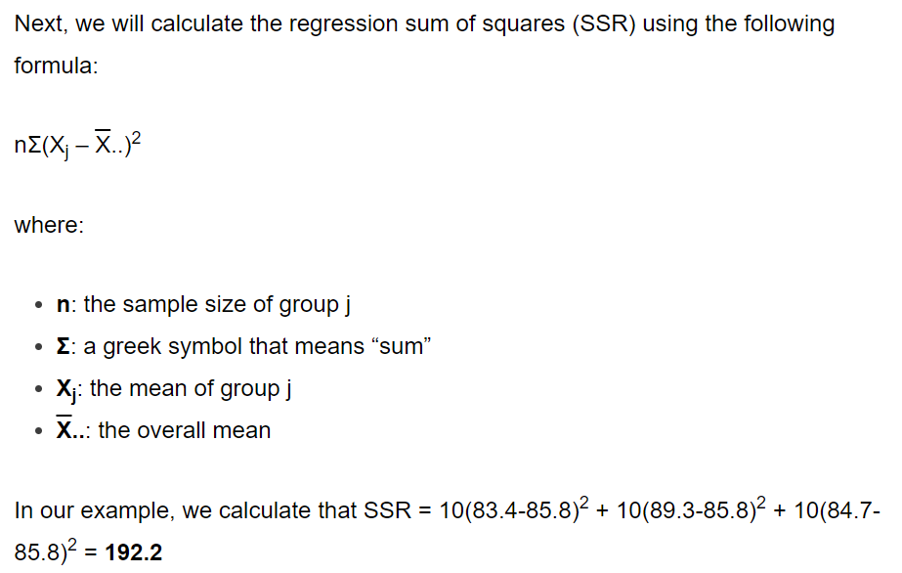
One-way ANOVA (Problem 1)
Step 2: Calculate SSR.
Between Groups

Slide 32
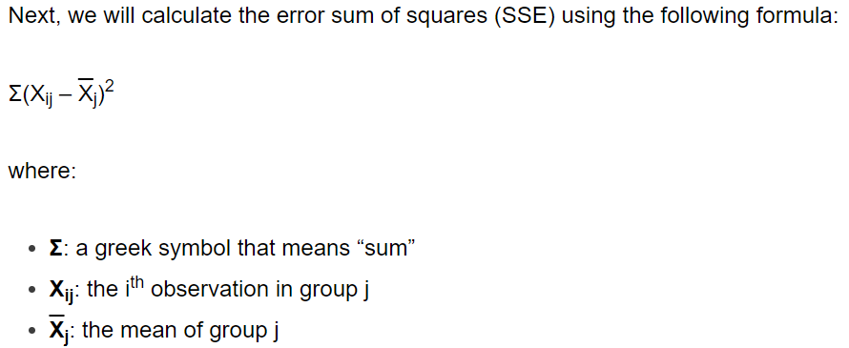
One-way ANOVA (Problem 1)
Step 3: Calculate SSE.
Within Groups

Slide 33
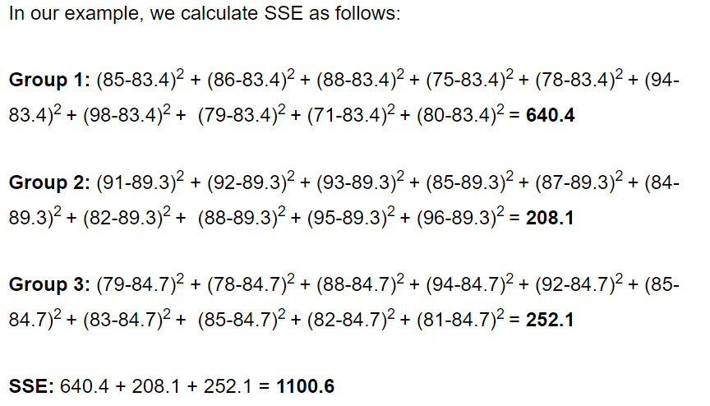
One-way ANOVA (Problem 1)
Step 3: Calculate SSE.
Within Groups

Slide 34
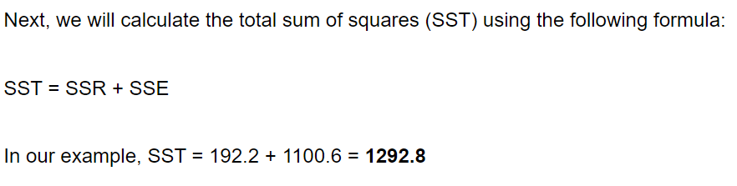
One-way ANOVA (Problem 1)
Step 4: Calculate SST.

Slide 35
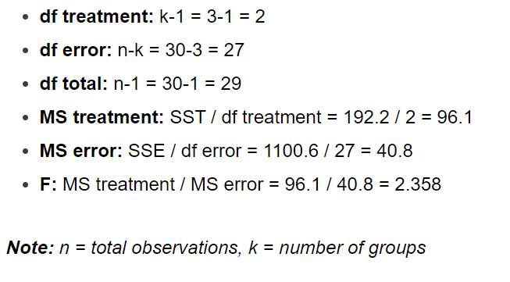
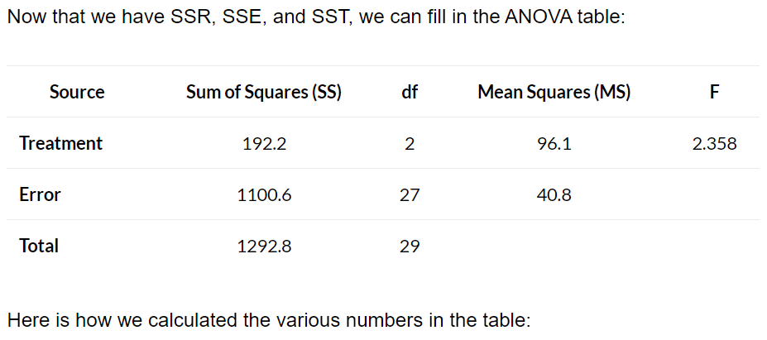
One-way ANOVA (Problem 1)
Step 5: Fill in the ANOVA table.

Slide 36
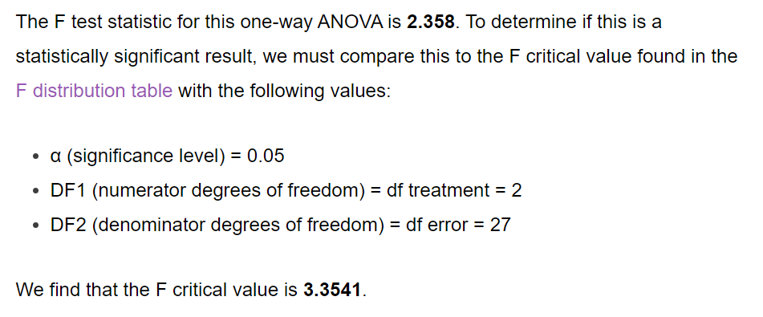
One-way ANOVA (Problem 1)
Step 6: Interpret the results.
If, F calculated falls within this region, then Accept the H0
2.358
-3.3541
3.3541

Slide 37
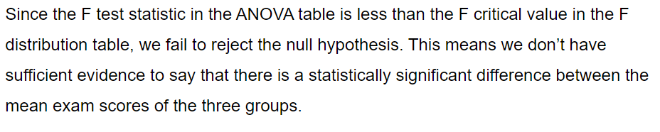
One-way ANOVA (Problem 1)
Step 6: Interpret the results.
F critical > F calculated → Accept the null hypothesis

Slide 38
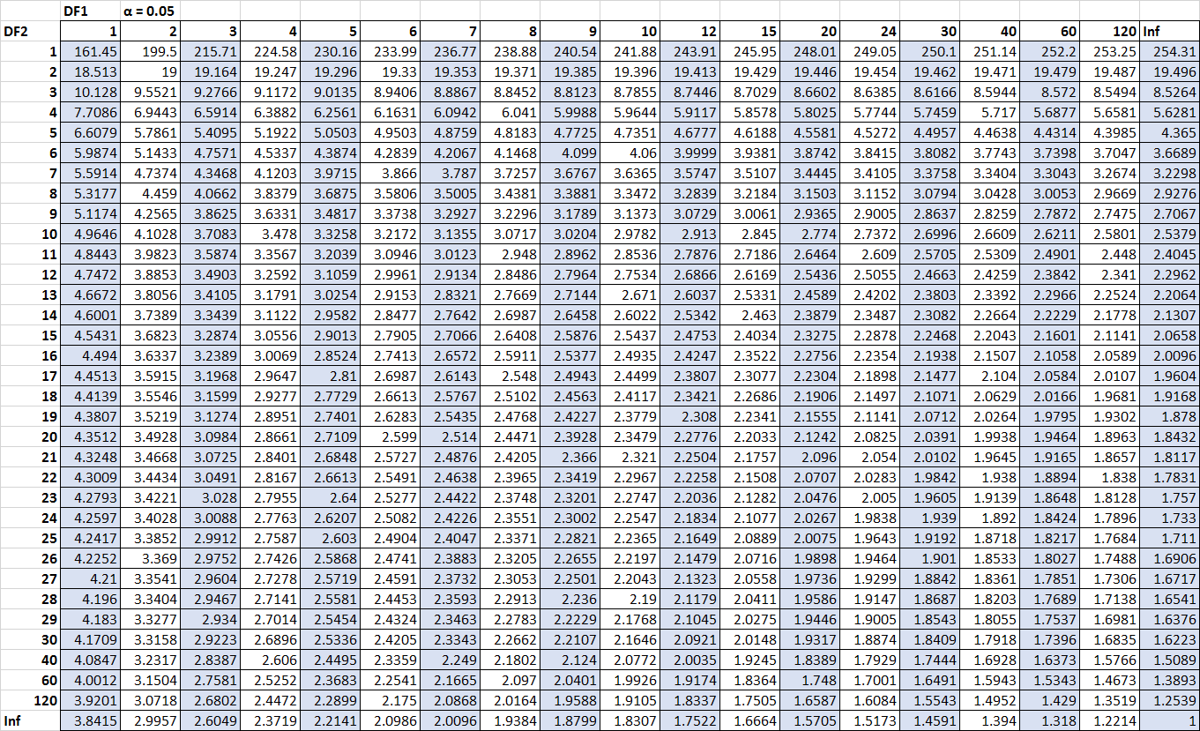
One-way ANOVA
F – Table with alpha = 0.05 (95% confidence interval)

Slide 39
One-way ANOVA (Problem 1 – Second Method)
The exam scores for each group are shown below:
Determine if the mean exam score is different between the three groups:

Slide 40
One-way ANOVA (Problem 1 – Second Method)
Step 1: Calculate Grand Total
Step 2: Count number of observations
Step 3: Calculate Correction Factor (C)
1
2
3

Slide 41
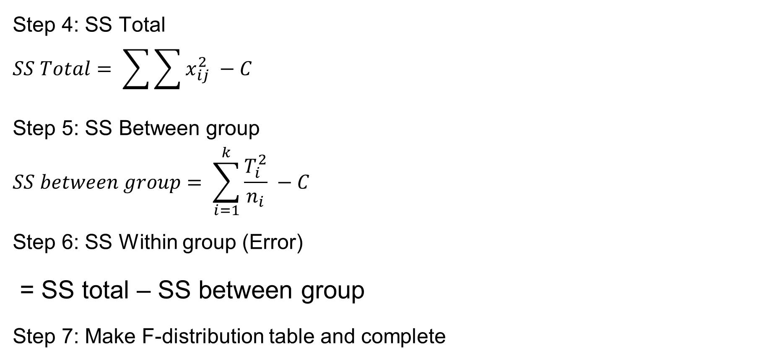
One-way ANOVA (Problem 1 – Second Method)
Step 4: SS Total
$$SS Total= \sum{\sum{x_{ij}^{2} −C}}$$
Step 5: SS Between group
$$SS between group= \sum_{i=1}^{k}{\frac{T_{i}^{2}}{n_{i}} −C}$$
Step 6: SS Within group (Error)
= SS total – SS between group
Step 7: Make F-distribution table and complete

Slide 42

One-way ANOVA (Problem 1 – Second Method)
Step 4: SS Total
$$SS Total= \sum{\sum{x_{ij}^{2} −C}}$$
= (85^2 + 86^2 + 88^2 + ..…+ 82^2 + 81^2) - C
= 222142 – 220849 = 1292.8

Slide 43

One-way ANOVA (Problem 1 – Second Method)
Step 5: SS Between group
$$SS between group= \sum_{i=1}^{k}{\frac{T_{i}^{2}}{n_{i}} −C}$$
= $\frac{{834}^{2}}{10}$+ $\frac{{893}^{2}}{10}$+ $\frac{{847}^{2}}{10}$ - C
= 221041 – 220849 = 192.2

Slide 44
One-way ANOVA (Problem 1 – Second Method)
Step 6: SS Within group (Error)
= SS total – SS between group
= 1292.8 - 192.2
SS within group (Error) = 1100.6
Step 7: Make F-distribution table

Slide 45
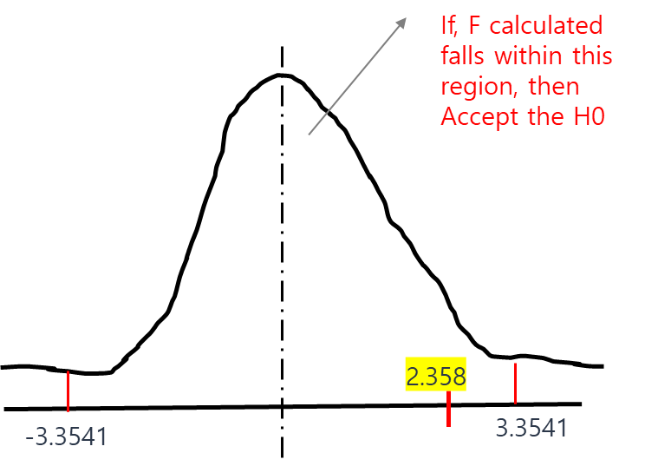
One-way ANOVA (Problem 1 – Second Method)
Step 8: Write recommendation or summary
F critical > F calculated → Accept the null hypothesis

Slide 46
One-way ANOVA (Problem 2)
The exam scores for each group are shown below:
Determine if the mean exam score is different between the three groups:
Group 1 | Group 2 | Group 3
51 | 23 | 56
45 | 43 | 76
33 | 23 | 74
45 | 43 | 87
67 | 45 | 56

Slide 47
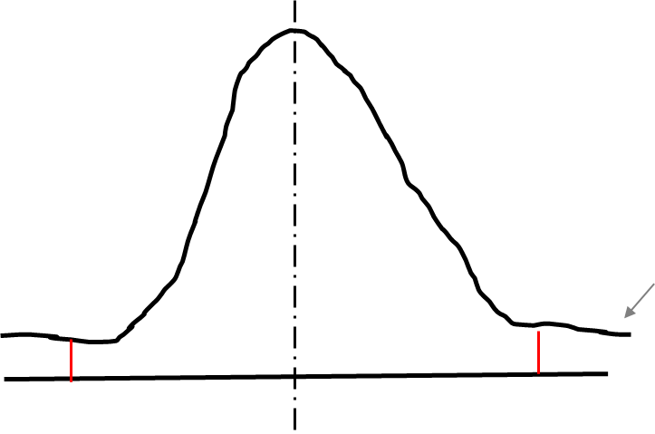


One-way ANOVA (Problem 2)
The exam scores for each group are shown below:
If, F calculated falls outside the curve, then Reject the H0
Between Groups
9.747
3.3541
Within Groups
From F-Table

Slide 48
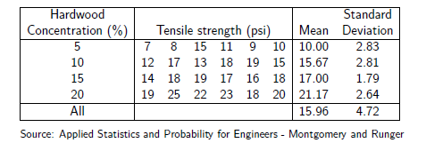
One-way ANOVA (Problem 3)
A paper manufacturer makes grocery bags. They are interested in increasing the tensile strength of their product. It is thought that strength is a function of the hardwood concentration in the pulp. An investigation is carried out to compare four levels of hardwood concentration: 5%, 10%, 15% and 20%. Six test specimens are made at each level and all 24 specimens are then tested in random order. The results are shown below:
Do all our groups come from populations with the same mean?

Slide 49
One-way ANOVA (Problem 3)
If, F calculated falls outside the curve, then Reject the H0
19.605
3.098

Slide 50
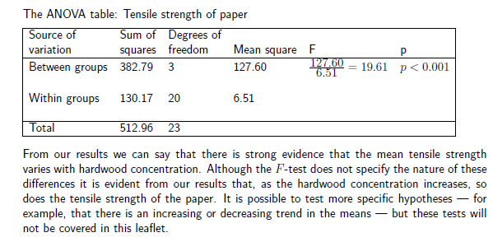
One-way ANOVA (Problem 3)

Slide 51
One-way ANOVA (Problem 4)
A pharmaceutical company conducts an experiment to test the effect of a new cholesterol medication. The company selects 15 subjects randomly from a larger population. Each subject is randomly assigned to one of three treatment groups. Within each treament group, subjects receive a different dose of the new medication. In Group 1, subjects receive 0 mg/day; in Group 2, 50 mg/day; and in Group 3, 100 mg/day. The treatment levels represent all the levels of interest to the experimenter, so this experiment used a fixed-effects model to select treatment levels for study. After 30 days, doctors measure the cholesterol level of each subject. The results for all 15 subjects appear in the table below:

Slide 52
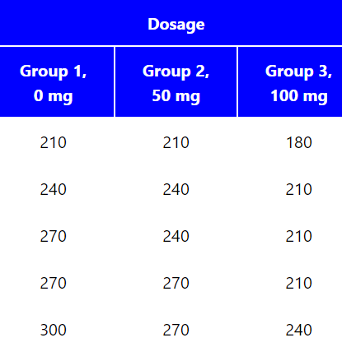
One-way ANOVA (Problem 4)
In conducting this experiment, the experimenter had two research questions:
Does dosage level have a significant effect on cholesterol level?
How strong is the effect of dosage level on cholesterol level?
To answer these questions, the experimenter intends to use one-way analysis of variance.

Slide 53
One-way ANOVA (Problem 4)
If, F calculated falls inside the region, then accept the H0
4.16
3.885

Slide 54
One-way ANOVA (Problem 5)
A trucking company wishes to test the average life of each of the four brands of types. The company uses all brands on randomly selected trucks. The records showing the lives (thousands of miles) are as given. Test the hypothesis that the average life for each brand of types is the same at 5% level of significance.
Brand 1 | 20 | 23 | 18 | 17 | -
Brand 2 | 19 | 15 | 17 | 20 | 16
Brand 3 | 21 | 19 | 20 | 17 | 16
Brand 4 | 15 | 17 | 16 | 18 | -

Slide 55
One-way ANOVA (Problem 5)
Remember, n- means the number of observations in each group. Here, Brand 1 and Brand 4 have observations of 4. But Brand 2 and Brand 3 have observations of 5. So, when substituting ‘n’ to calculate SSR, we need to use n=4 for Brand 1 & 4; n = 5 for Brand 2 & 3.

Slide 56
Two-way ANOVA
The two-way ANOVA compares the mean differences between groups that have been split on two independent variables (called factors).
The primary purpose of a two-way ANOVA… is to understand if there is an interaction between the two independent variables on the dependent variable.
For example, you may want to determine whether there is an interaction between physical activity level(IV) and gender(IV) on blood cholesterol concentration(DV) in children.

Slide 57
Two-way ANOVA
Assumptions
Assumption #1: Your dependent variable should be measured at the continuous level (i.e., they are interval or ratio variables).
Assumption #2: Your two independent variables should each consist of two or more categorical, independent groups.
Assumption #3: You should have independence of observations, which means that there is no relationship between the observations in each group or between the groups themselves.
Assumption #4: There should be no significant outliers. Outliers are data points within your data that do not follow the usual pattern
Assumption #5: Your dependent variable should be approximately normally distributed for each combination of the groups of the two independent variables.
Assumption #6: There needs to be homogeneity of variances for each combination of the groups of the two independent variables.

Slide 58
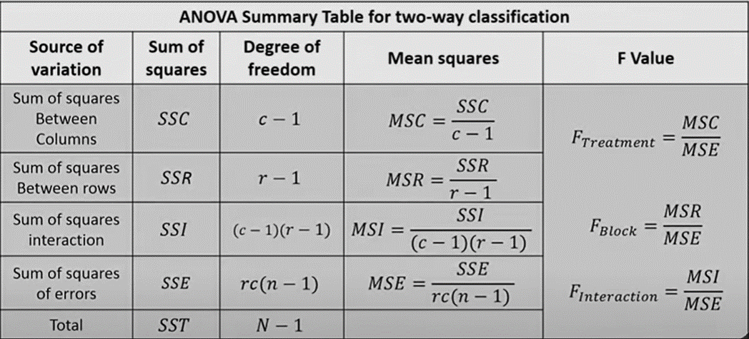
Two-way ANOVA (with interaction) method 1

Slide 59
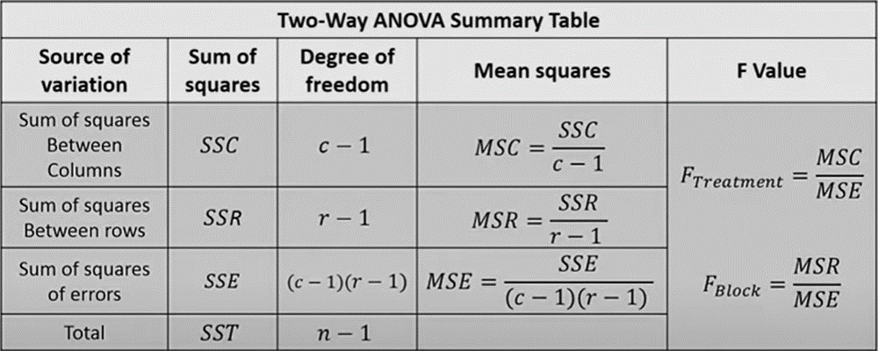
Two-way ANOVA (without interaction) method 2

Slide 60
Two-way ANOVA (Problem 1 )
An engineer is studying methods for improving the ability to detect targets on a radar scope. Two factors she considers to be important are the amount of background noise, or “ground clutter,” on the scope and the “type of filter” placed over the screen. The response variable is intensity level. It is experienced that the ground clutter can be categorized into three levels, ie., low, medium, and high and two filter types are available in the market.

Slide 61
Two-way ANOVA (Problem 1)
Two factors: Ground Clutter type & Filter Type
Response variable: Intensity level
DF for clutter = a – 1 = 3-1 = 2
DF for Filter = b – 1 = 2 – 1 = 1
DF for interaction = (a -1) (b-1) = 2
DF for errors = ab(n-1) = 2 * 3 *(4-1) =18
DF for total = N – 1 = 24 – 1 = 23
a = number of levels in factor 1 (clutter)
b = number of levels in factor 2 (filter)
n = number of replicates in each condition
N = abn

Slide 62
Two-way ANOVA (Problem 1)
Step 1: Calculate Row, Column, and Grand Total
Step 2: Count the total number of observations = N = 24
Step 3: Calculate Correction Factor (C) = (Grand Total^2) / N = 2288^2/24 = 218122.7
Grand Total

Slide 63
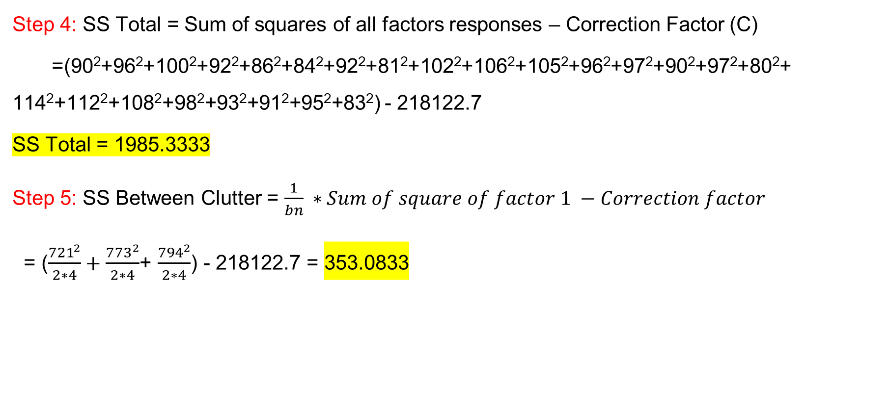
Two-way ANOVA (Problem 1 )
Step 4: SS Total = Sum of squares of all factors responses – Correction Factor (C)
=(90²+96²+100²+92²+86²+84²+92²+81²+102²+106²+105²+96²+97²+90²+97²+80²+ 114²+112²+108²+98²+93²+91²+95²+83²) - 218122.7
SS Total = 1985.3333
Step 5: SS Between Clutter = $\frac{1}{bn} ∗Sum of square of factor 1 −Correction factor$
= ($\frac{{721}^{2}}{2∗4}+\frac{{773}^{2}}{2∗4}$+ $\frac{{794}^{2}}{2∗4}$) - 218122.7 = 353.0833

Slide 64

Two-way ANOVA (Problem 1 )
Step 6: SS Between Filter = $\frac{1}{an} ∗Sum of square of factor 2 −Correction factor$
= $\frac{1}{3 ∗ 4}∗$[(306+314+313+286) ²+(276+265+284+244)² ] - 218122.7 = 937.5

Slide 65

Two-way ANOVA (Problem 1 )
Step 7: SS Interaction = $\frac{1}{n} ∗Sum of square of both factor 2 −Correction factor$ – SS Clutter – SS Filter
= $\frac{1}{4}$(378² +409² + 432² + 343² +364² + 362²) – 218122.7 – 353.08333 – 937.5
SS Interaction = 81.25

Slide 66
Two-way ANOVA (Problem 1 )
Step 8: SS Error = SS Total – SS Clutter – SS Filter – SS Interaction
= 1985.333 – 353.0833 – 937.5 – 81.25
SS Error = 613.5
Step 9: Make ANOVA Table

Slide 67
Two-way ANOVA (Problem 2)
Suppose you want to determine whether the brand of laundry detergent used and the temperature affects the amount of dirt removed from your laundry. To this end you buy two detergents with different brand (“Super” and “Best”) and choose three different temperature levels (“cold”, “warm” and “hot”). Then you divide your laundry randomly into “4*r” pile of equal size and assign each ‘r’ piles into the combination of (“super” and “Best”) and (“cold”, “warm” and “hot”). In this example, we are interested in testing Null Hypothesis.
H_{0D} = The amount of dirt removed does not depend on the type of detergent.
H_{0T} = The amount of dirt removed does not depend on the temperature.

Slide 68
Two-way ANOVA (Problem 2)
The example has two factors(factor detergent, factor temperature) at a=2(Super and Best) and b=3(cold, warm and hot) levels. Thus, there are a*b = 3*2=6 different combination of detergent and temperature with each combination. There are r=4 loads. (r is called the number of replicates). This sums up to “n=a*b*r”=24=2*3*4 loads in total.

Slide 69
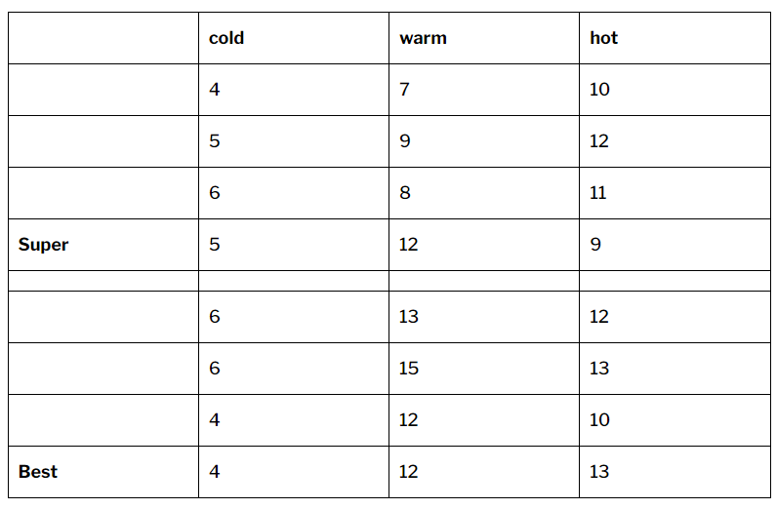
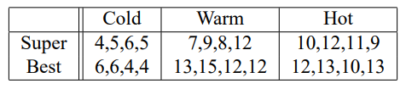
Two-way ANOVA (Example problem)
The amounts of Y(ijk) of dirt removed when washing sub pile k(k=1,2,3,4) with detergent i(i=1,2) at temperature j(j=1,2,3) are recorded in table below:-

Slide 70
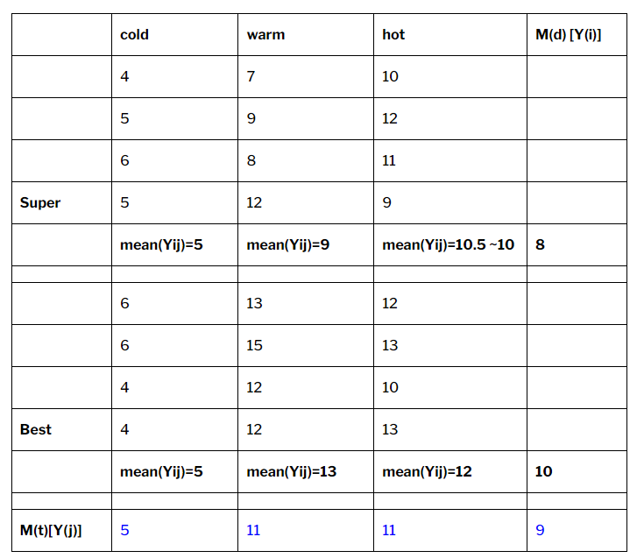
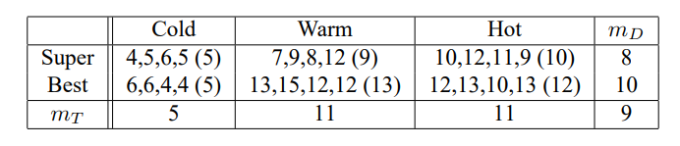
Two-way ANOVA (Example problem)
Solution:
Calculate mean
We have calculated all the means like detergent mean(Md), temperature mean(Mt) and mean of every group combination.
Now what we only have to do is calculate the sum of squares(ss) and degree of freedom(df) for temperature, detergent and interaction between factor and levels.

Slide 71

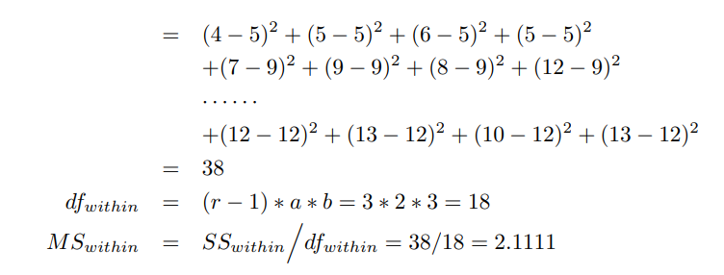
Two-way ANOVA (Example problem)
Step 1:
Calculate of SS (within) and df(within) is:

Slide 72
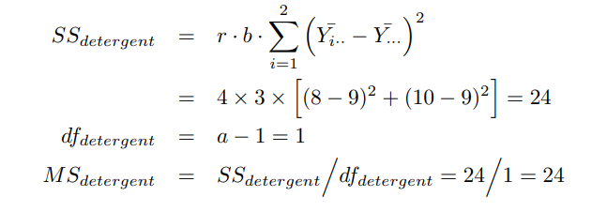
Two-way ANOVA (Example problem)
Step 2:
Calculate of SS (detergent) and df(detergent) and MS(detergent)

Slide 73
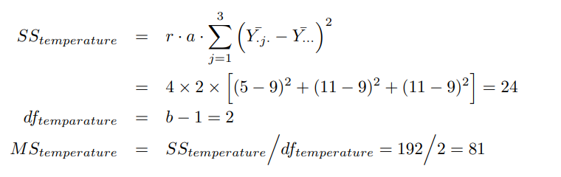
Two-way ANOVA (Example problem)
Step 3:
Calculate of SS (temperature), df(temperature) and MS(temperature)

Slide 74
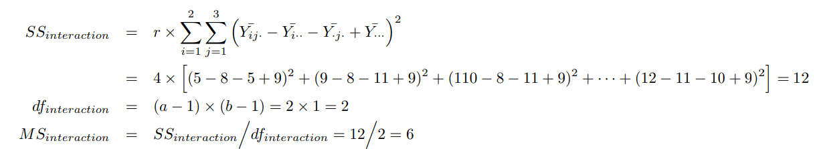
Two-way ANOVA (Example problem)
Step 4:
Calculate of SS (interaction), df(interaction) and MS(interaction)

Slide 75
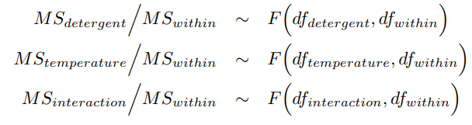
Two-way ANOVA (Example problem)
Step 5: F-Test
Notes:
https://statweb.stanford.edu/~susan/courses/s141/exanova.pdf

Slide 76
Thank you
Reference:
Douglas C. Montgomery. Design of Experiments. Eighth Edition.

